Slide 1
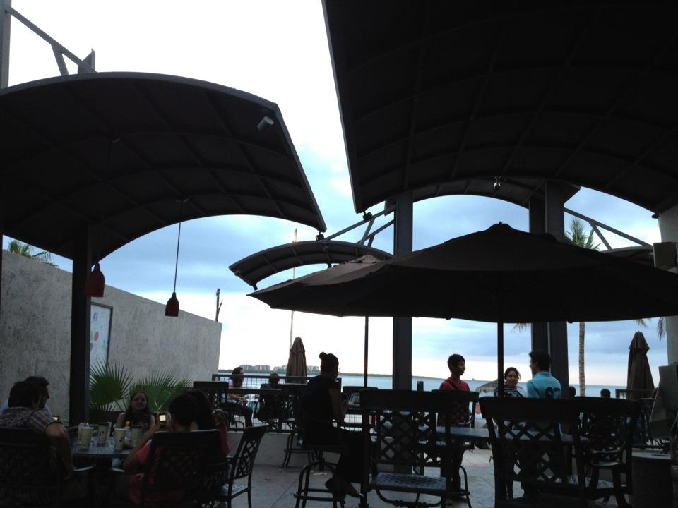

CRITICAL APROACHES TO THE SUSTAINABLE PRODUCTION OF WATERSCAPES
MELISSA HAEFFNER, PHD
@melissahaeffner
Post-doctoral researcher
iUTAH, Utah State University
AESS Washington DC/June 2016
Critical Sustainability Panel
Notes:
I argue that urban water development in La Paz has been “produced” and as evidence, I will demonstrate stages of production in which certain choices were made over others. I further argue that the production of waterscapes can be exposed through triangulating multiple and contesting narratives, providing a foundation to critically review so-called sustainability goals to ask for whom and for what.

Slide 2
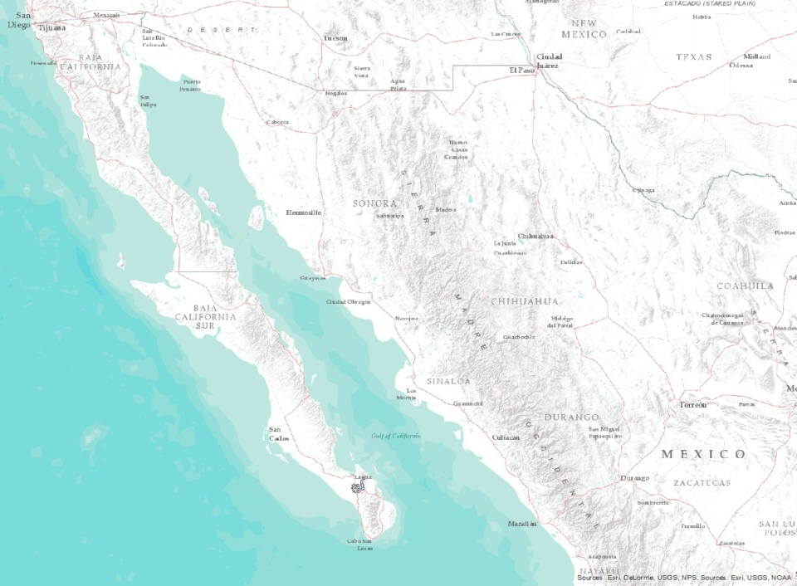
Research Question: How has the La Paz watershed been produced over time and space, and how does knowing this help us go forward towards sustainability?
Study Area
Source: ESRI USOS NOAA
MELISSA HAEFFNER, PHD AESS Washington DC/June 2016
Critical Sustainability Panel
Notes:
1. Underscores the idea that resilience is local

Slide 3
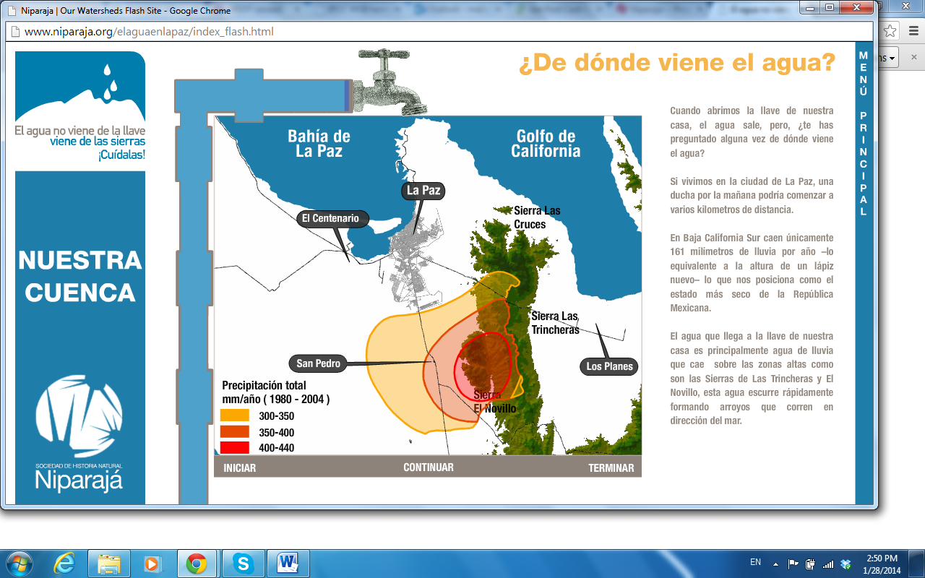
Map showing elevation (green), and gradient of annual mean precipitation (red = high, orange = medium, yellow = low). Source: (Niparajá, 2014)
MELISSA HAEFFNER, PHD AESS Washington DC/June 2016
Critical Sustainability Panel

Slide 4
Precipitation Trends in La Paz
Annual time series of the Palmer Modified Drought Severity Index (PMDI) for La Paz, Mexico where the y-axis represents wetness (positive) to dryness (negative). Source: (NOAA, 2012)
MELISSA HAEFFNER, PHD AESS Washington DC/June 2016
Critical Sustainability Panel

Slide 5
Population Growth Baja California Sur, Mexico 1895-2015
Source: INEGI, 2012
MELISSA HAEFFNER, PHD AESS Washington DC/June 2016
Critical Sustainability Panel
Notes:
BCS is also facing social challenges alongside climate challenges.

Slide 6
Methods
Sector | Level
Technological | Federal
Technological | State
Science | State
Science | State
Science | Local
Science | Local
Policy | Federal
Policy | State
Policy | State
Policy | State
Policy | State
Distribution | Local
Distribution | Local
Socio-cultural | Federal
Socio-cultural | State
Socio-cultural | State
Socio-cultural | State
Haeffner, M., forthcoming
MELISSA HAEFFNER, PHD AESS Washington DC/June 2016
Critical Sustainability Panel

Slide 7
Urban Water Infrastructure Development in La Paz, 1960s-present
pre-
1960s
1970s
1980s
1990s
Early 2000s
present
Saltwater intrusion Switch to public services 1st sewer pipes installed
State Water Plan passed Sanitation decentralized to municipalities Wells moved further inland Urban sewer expansion reaches 86%
National Water Quality regulations passed 1st greywater treatment plant built
NAFTA passed
Federal funds disbursed for drought Municipality elects politicians from opposed federal party Beach federally protected
92% pipe coverage 33 wells (6-8 saltwater intrusion) 30% water meter coverage Water User Associations established
future
2 new dams Desalination proposal Education Collaborative initiatives
Aquifer studies commissioned Baja California Sur becomes a State of Mexico Category 4 Hurricane Liza claims lives
Haeffner, M., forthcoming
MELISSA HAEFFNER, PHD AESS Washington DC/June 2016
Critical Sustainability Panel
Notes:
In addition,
I argue that the temporal dimension is key in understanding both the current resilience and current vulnerability of the built environment.

Slide 8
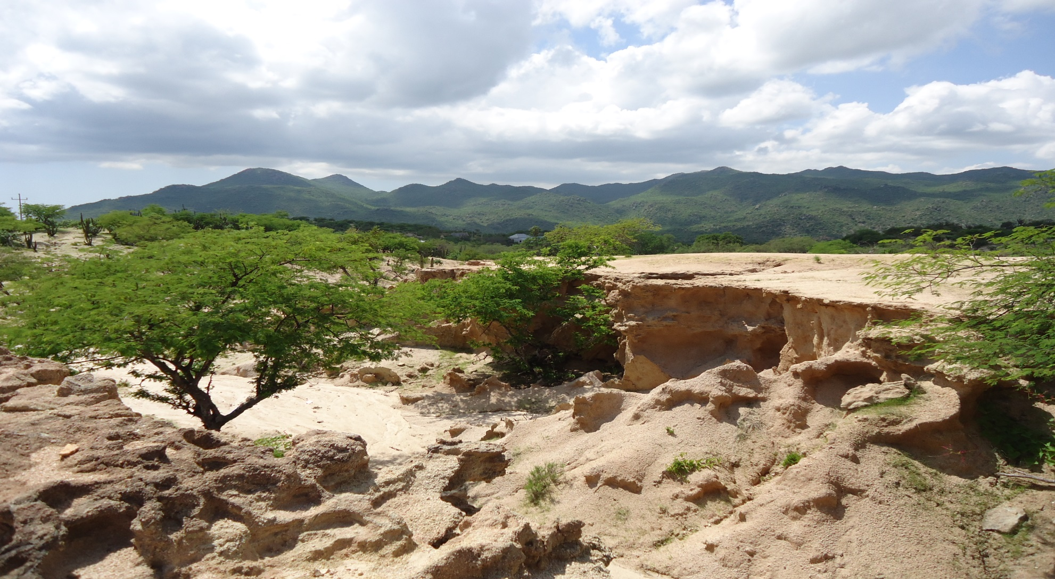
Pre-1960s | Indigenous, Colonialism, Mexican territory
MELISSA HAEFFNER, PHD AESS Washington DC/June 2016
Critical Sustainability Panel

Slide 9
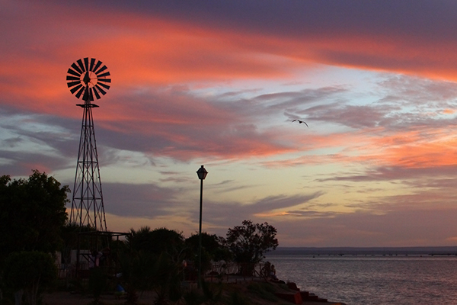
1960-70s | Public delivery of fresh water supplies
Photo credit: Rob McKinstry
https://www.behance.net/gallery/2079736/Travel-and-Event-Photography
MELISSA HAEFFNER, PHD AESS Washington DC/June 2016
Critical Sustainability Panel
Notes:
Produced

Slide 10
1970-80s | Local and state awareness
“The State Plan of the 1980s was to change the agricultural uses of wells… They also began to reuse greywater and to treat wastewater so they could stop drawing water from the aquifer, and to balance extraction with recharge.”
MELISSA HAEFFNER, PHD AESS Washington DC/June 2016
Critical Sustainability Panel
Notes:
Produced

Slide 11
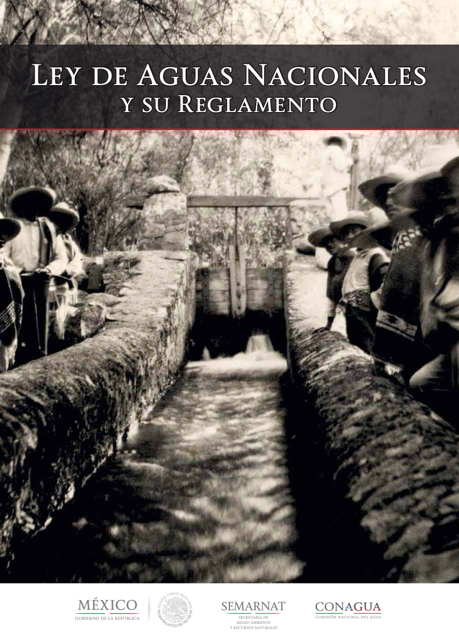
1980-90s | Top-down water reform
MELISSA HAEFFNER, PHD AESS Washington DC/June 2016
Critical Sustainability Panel
Notes:
Produced

Slide 12
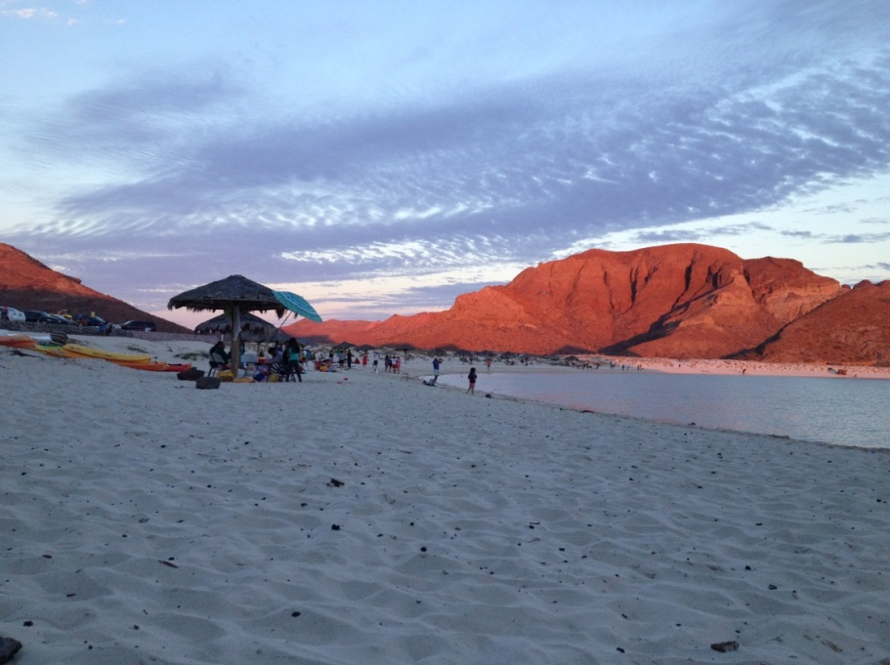
1990-2000s | Reliance on municipal capacity
“From 1998 to 2010, the administrations of the municipality were different [political] parties [than the federal government], so federal programs failed. La Paz elected PAN and then PRD, so resources simply did not arrive…for this reason there was no growth in the hydraulic system, drinking water, drainage, etc.”
MELISSA HAEFFNER, PHD AESS Washington DC/June 2016
Critical Sustainability Panel
Notes:
Produced, contested narratives

Slide 13
2010 - present | Aligning federal, state and local goals
“There has been a lot of coordination in the last two years and we have advanced much more in environmental issues. The Office of Sustainable Development coordinated the State Climate Change Plan with the University, we did the Oasis Sudcalifornianos program, Solid and Urban Waste also was a very large step forward, the State Solid Waste Management Plan was made and municipal plans are underway, proposals for environmental legislation by our Office are being made.”
MELISSA HAEFFNER, PHD AESS Washington DC/June 2016
Critical Sustainability Panel

Slide 14
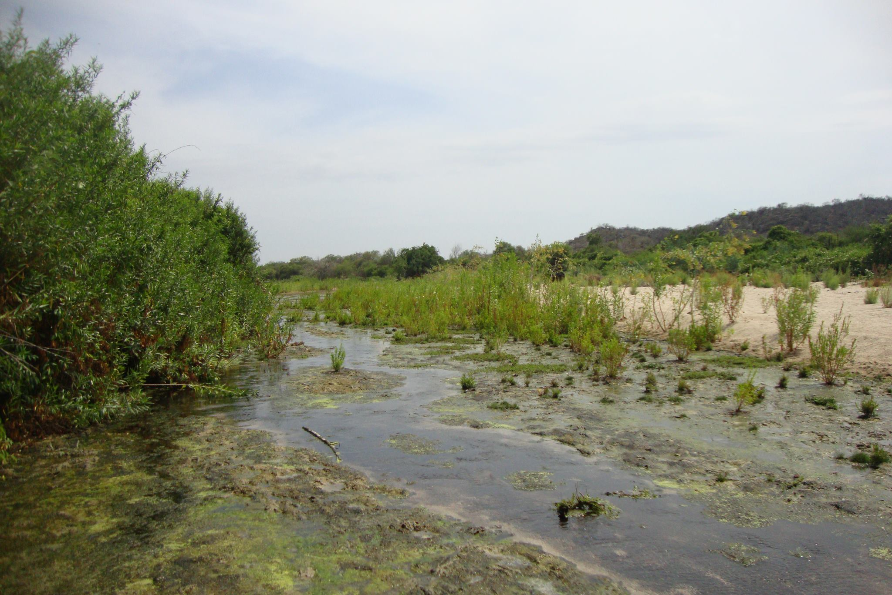
Rain
80% Evaporation
Runoff (surface)
Aquifer (ground)
Rural users
Rural Water Sources
Ocean
Streams
Personal wells
Haeffner, M., forthcoming
MELISSA HAEFFNER, PHD AESS Washington DC/June 2016
Critical Sustainability Panel
Notes:
What the telling of history tells us

Slide 15
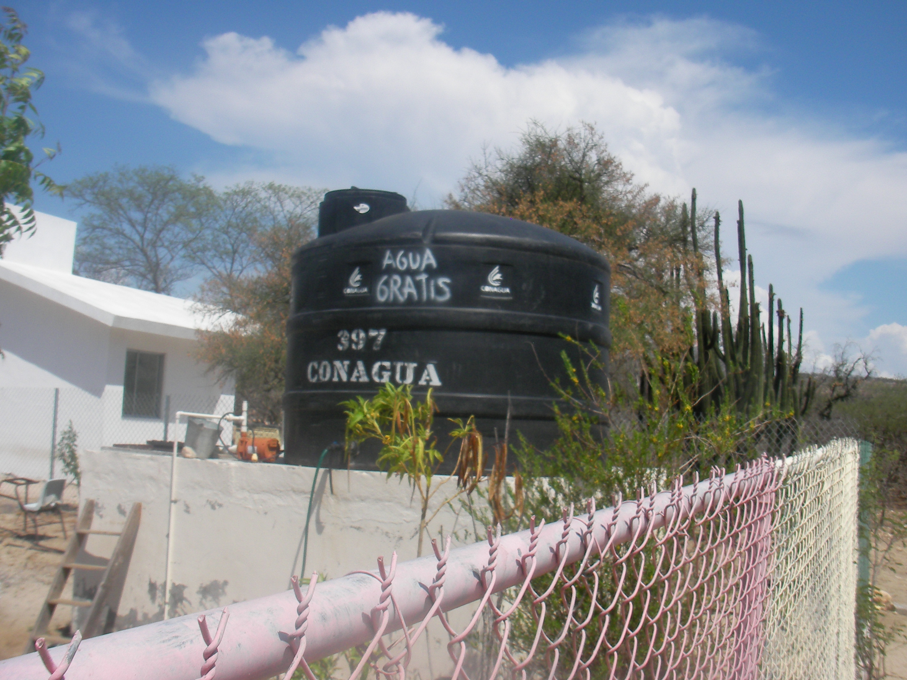
Urban-Rural Water Sources
Rain
80% Evaporation
Runoff (surface)
Aquifer (ground)
Treatment plant
Urban users
Rural users
Ocean
Aqueducts
Streams
Desalination
Personal wells
Tourism
Haeffner, M., forthcoming
MELISSA HAEFFNER, PHD AESS Washington DC/June 2016
Critical Sustainability Panel

Slide 16
Latour, B. (2004) Why has critique run out of steam? From matters of fact to matters of concern. Critical Inquiry (30): 264.
"The critic is not the one who debunks, but the one who assembles. The critic is not the one who lifts the rugs from under the feet of the naive believers, but the one who offers the participants arenas in which to gather."
MELISSA HAEFFNER, PHD AESS Washington DC/June 2016
Critical Sustainability Panel

Slide 17
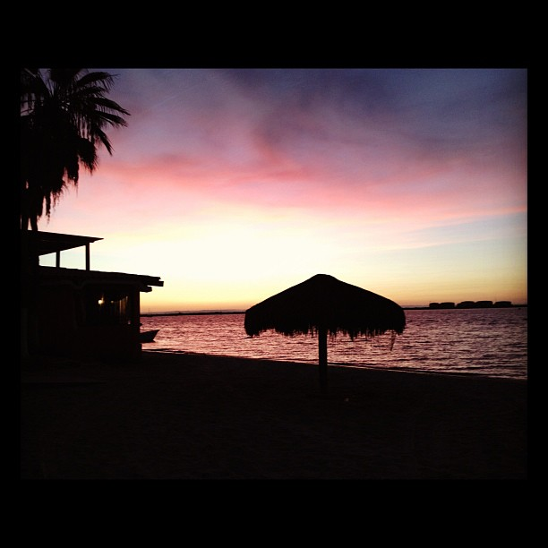
Thank you
Melissa Haeffner, PhD
Post-doctoral Researcher (RF2: People, Places and Pipes)
iUTAH (innovative Urban Transitions and Aridregion Hydro-sustainability)
Utah State University
melissahaeffner@gmail.com
www.linkedin.com/in/melissahaeffner
Notes:
The two case studies demonstrate that resilience is at its core local
Furthermore, soft infrastructure – networks and institutions
Shape ability of those living in systems to adapt or not to external drivers
Social science contributes to increased resilience by identifying critical social variables that technical metrics and tools might miss
Built environment
Contribute to NIST
Thank you. I’d be happy to take any questions.

